Slide 1
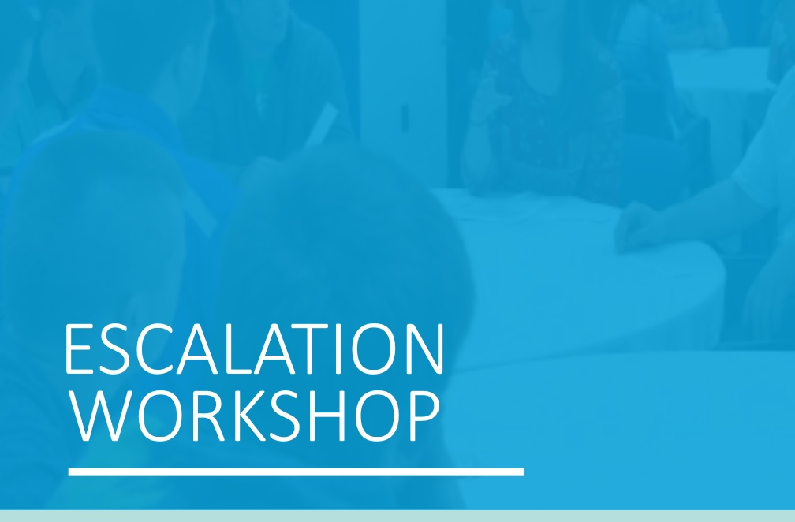


Slide 2
About:
One Love Foundation
The One Love Foundation was created in 2010 after Yeardley Love, a senior at UVA, was killed by her ex-boyfriend. Her family started One Love to raise awareness and educate students about the warning signs of relationship abuse.
To learn more visit: https://www.joinonelove.org/

Slide 3
Trigger
Warning
The film that we are about to watch depicts examples of relationship abuse including sexual, physical, and emotional abuse.
This is a very heavy film and can be difficult to watch, even if you have not been in a similar situation.
Please take care of yourself and feel free to leave the room or put your head down at any time.
We have handed out a list of campus resources – please turn to them if you need any assistance after the workshop.
Notes:
Introduce counselor in the room

Slide 4
Inclusivity
This film portrays just one example of relationship violence.
While it shows a white, heterosexual, college-aged couple portraying male on female violence – this is an issue that is prevalent amongst all types of relationships, no matter the gender, sexuality, class, ability or race.
The film is to be used as a catalyst to start a conversation about relationship abuse in many different types of relationships.

Slide 5
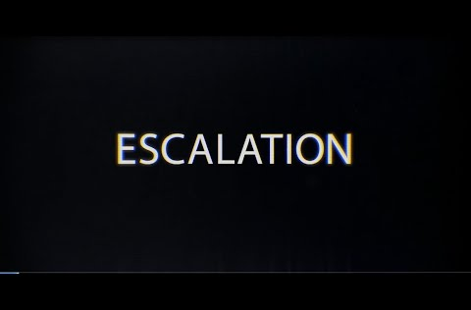

Slide 6
Question 1
How are you feeling?
What are you thinking after having watched this film?
Notes:
Set the tone.
Your response to the first answers can set the tone for the entire rest of the discussion.
Thank people for participation.
Use verbal and also non-verbal cues such as nodding and smiling to encourage them to continue sharing.
Unhealthy and abusive relationships have their happy times too -- especially in the beginning stages.
We see that in the beginning, Paige and Chase's relationship seems really great, but we can’t ignore the negative times that follow. In fact, most abusive relationships do seem perfect in the beginning, almost like it is "too good to be true." For this reason, it can be especially hard to recognize when a relationship turns abusive, and people often stay in the relationship in the hopes that it will revert back to the good times.

Slide 7

Question 2
What were your first impression of Paige and Chase, and how their relationship began?
Why could it be dangerous to rush into dating someone before taking time to know them?
Notes:
Rushing into a relationship could be dangerous.
The relationship started out very quickly, which is a warning sign of an abusive relationship. That is not to say that every relationship that starts out quickly will become abusive, but it happens to be a common thread in abusive relationships, so this is something to be aware of.
Set the pace together.
Chase was the one who always pushed the relationship forward, which can be a sign that the person wants control and will be possessive. In a healthy relationship, both people set the pace together and both people feel equally satisfied with the pace.
Take your time getting to know someone.
While Chase seemed like a romantic and courteous person at first, in reality, Paige only knew him for a few days when they started dating. People don’t always turn out to be as sweet or as courteous as they act in the beginning, and some people who are abusive will intentionally act extra nice in the beginning to lure you in.

Slide 8
Question 3
We see that Paige’s friends were actually very supportive in the beginning stages of the relationship, by saying things like, “You 2 are so cute!” How could it be potentially harmful for your friends to be speaking only positively about your relationship in the beginning stage?
Notes:
There is a “perfect” relationship paradox.
If everyone is telling you that your relationship is “perfect,” and that you are “so cute together,” you may be more likely to ignore negative things that begin to happen, and blow them off as not a big deal. Also, since everyone else is saying you’re great together you might not want to share negative feelings with your friends or family members, because you don’t want to let them down, or want them to believe that you truly are a “perfect couple.”
Friends don’t always have the full picture.
While it is tempting to rely on friends’ opinions, remember that they only see the outer layer of a relationship, so it is important to focus on how the relationship is actually making you feel, and be honest with yourself and with your friends about that.
Be mindful of your influence as a friend.
As a friend, keep in mind that things you say may influence your friend whether you know it or not. Be mindful about the conversations that you have with your friends about their relationships, and encourage honesty about how their partner makes them feel. Ask them questions like, “How is everything going?” or “What did you and your partner do this weekend?” to spark a conversation, and encourage your friends to be open and honest with you.
Societal pressure to be perfect.
There is incredible pressure to be in a seemingly perfect relationship, and social media only accentuates this pressure. Think about the pressure to post the perfect selfie with your partner. Remember as a friend that even if you are seeing the happiest posts on social media, that is not the only representation of your friend’s relationship. So as a friend, continue to ask genuine questions about how the relationship is going and do not assume that because it looks great on social media that everything is perfect.

Slide 9
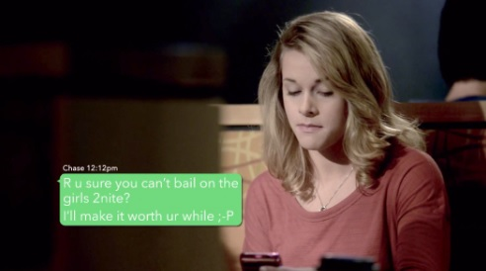
Question 4
When did you first notice signs that there was maybe something off about Chase? Why was that a warning sign?
Notes:
Controlling isn’t caring.
Someone who comes on too strong right away, is easily jealous, and/or limits their partner’s freedom is showing early signs of abusive behavior. These emotionally unhealthy behaviors could lead to physical and sexual abuse down the line. Even if they never develop to those levels, these are still unhealthy and controlling behaviors that are not acceptable.
There is a difference between healthy and unhealthy passion.
There are healthy ways to show passion and unhealthy ways to show passion. Healthy passion feels mutual, respectful, and uplifting. Unhealthy passion feels confusing, overwhelming, chaotic, and scary. If you observe examples of unhealthy passion in movies, music, and TV, you will see it everywhere – and it’s even portrayed as a good thing! In real life, people express healthy passion by balancing their strong emotions with strong respect for what the other person is feeling, too.
Create a healthy balance between your relationship and the other important things in your life.
In an unhealthy relationship, one partner pressures another to cut ties with friends, family and other people; it crosses the line from “we are excited to spend time together” to “I need you to spend all of your time with me.”
An abusive partner will often use isolation as a tactic to weaken a person’s support network and therefore have power over that person. It is important to find a balance between spending time with your partner, and spending time with your family and friends. In healthy relationships, your partner should make an effort to get to know the people in your life that are important to you (such as family and friends).
Be wary of insecure attachment styles.
People who attach too soon, expect too much, or seem like they would fall apart without you are exhibiting unhealthy behaviors. If you have a friend or partner who seems to have an insecure attachment style, gently point that out to them and encourage them to seek Counseling
If you can't talk to your partner, that's a sign that something is off.
If you feel that something is isn't right, talk to your partner about it. If you are unable to approach your partner or if they are not listening to you, that is a sign that the relationship is not healthy.
Be approachable as a friend.
If you suspect that your friend is experiencing abuse, it is important to be approachable and non-judgmental. Speak with your friend about how their relationship is going – let them know that you are there for them and that you will support them no matter what, but that they deserve to be treated well and deserve to feel happy in their relationship.
Emotional abuse is incredibly harmful.
Insults such as “those pants make you look fat,” belittling, and other forms of emotional abuse have serious consequences – not only because they break down a person’s confidence, but also because a person actually may start to believe that these things about them are true. Remember that emotional abuse is a tactic that the perpetrator uses to control and manipulate their partner, and to make them believe that they are lucky to be with the abuser.
Often in LGBTQ relationships, emotional abuse may include homophobic insults and making you feel as though you deserve abuse because of your sexual orientation or gender expression. This may also include blackmailing you over your orientation or gender identity. It is important to remember that no matter your gender or sexual orientation, abuse is never okay.

Slide 10

Question 5
In one scene, we see Paige and Chase go into Chase’s room at a party and begin to hook up on his bed. The next thing we see is Paige waking up in the morning with an interesting look on her face. While we don’t see exactly what happened, what are some possibilities of things that could have happened? If they had sex, was it consensual?
What do you think Paige was thinking when she woke up after spending the night with Chase?
Notes:
Consent is an active “yes,” not just an absence of “no.”
Consent needs to be given and received before engaging in any sexual activity. It also needs to be given and received consistently throughout that activity, and can be revoked at any time. Lack of protest or resistance does not mean consent. Silence does not mean consent.
Consent cannot be given if a person is incapacitated.
Incapacitation means that a person lacks the ability to voluntarily agree to sexual activity because the person is asleep, unconscious, or under the influence of drugs, alcohol, and/or medication.
Remember that you and your partner can always choose to have sex later when you are both sober, but you can’t choose to take something back. It is best not to take a risk, as you could be assuming that your partner is interested in having sex, when in fact they are not.
Being sexually selfish is a red flag for abuse.
Abusive, controlling people often pressure or force their partners to engage in sexual activity sooner than they want as a means of control. In healthy relationships, people verbally communicate what
they feel ready for, when they are ready, and how they want to be sexually active. If you assume that your partner is ready to have sex but don’t ask, or if you assume that your partner is into the same sexual things that you are into, acting on those assumptions is perpetrating sexual violence. In fact, the most dangerous perpetrators of physical partner violence have typically also perpetrated some form of sexual abuse at some point in the relationship
Healthy relationships are about both parties’ comfort levels.
There are a lot of reasons why people have sex even when they are not 100% into it. They may feel guilty for “leading someone on,” that anybody else in their position would be lucky to have sex with this person so they should too, or that they have to keep the other person sexually satisfied or they will get dumped. No matter the reason, a healthy relationship is about fun, pleasure, and real sexual satisfaction—all of which come from knowing that both people are feeling equally happy. If it’s all about one person’s agenda, that’s a bad sign. Just because someone is your partner, or because they say “I love you,” that does not mean that you need to have sex with them.
If you feel that something is off after having had sex with someone, talk about it!
If Paige consented to having sex and then woke up the next morning feeling regretful, upset, or even confused, it's vital that she has a conversation with someone she trusts about how she is feeling. In a healthy relationship, you are able to be honest with your partner about how you are feeling. But, if you find that you are not able to talk to your partner, that's a red flag of an unhealthy relationship. It is also a sign that your relationship is abusive if you do approach your partner and
they belittle you, do not listen to you, or get overly defensive.
Always play it safe.
If you are considering having sex with someone, whether you're in a relationship with them or not, it's always better to play it safe and wait until you're absolutely certain that this is something you want to do. You can always choose to have sex with them later, but you can't choose to take it back. Also, if you are the slightest bit unsure whether or not the person you are with wants to have sex, it's vital to ask or wait. Again, you can always decide to have sex later on.

Slide 11
Question 6
Although Paige seemed uncomfortable after Chase pushed her down on the bed, she doesn’t seem to consider breaking up with him. Why not?
Why do you think Chase feels like he can get away with what he did?
Notes:
Abuse is not just physical.
It can be confusing when someone you like does something that makes you unhappy, and it is possible that you don’t even see their abusive behavior as abusive. However, it is important to remember that abuse comes in many forms. Feeling pushed around, held against your will, kept from your school work or job, or controlled in terms of who you can see or talk to are abusive behaviors – even if they are covered up with kind words.
Often times when abusive situations happen, it is followed by the abuser doing or saying something very nice, which then makes you minimize the original abusive behavior.
This is also known as the Cycle of Abuse.
Don't ignore your initial gut feeling.
If your gut tells you “something is a little bit off,” do not ignore this—really think about it, and ask friends, family, teachers, and counselors for input. Keep track of how often you have negative feelings, and if you feel them more often than not, and you don’t feel comfortable talking to your partner about those feelings, that is a warning sign that your relationship is unhealthy.
There is a difference between healthy and unhealthy conflict.
While all relationships have conflict, there is a difference between healthy conflict and unhealthy conflict. With healthy conflict, you are able to have a discussion with your partner about what it was that upset you, and they listen. When someone does something that makes you unhappy in an abusive relationship, it is tempting to brush it off as normal conflict, but keep in mind that if you feel like you can’t talk to your partner about what happened, that is a sign that your relationship is unhealthy.
Don't expect that your partner's behavior will change.
If a person is fantastic 95% of the time and controlling 5% of the time, that’s not good enough. If you are in a relationship with someone in which the ‘little things’ seem off, it can be tempting to believe that you can fix the person, teach them the right way to behave in a relationship, or blame their behaviors on stress or other factors. Everyone deserves to be in a relationship that is 100% non-controlling, safe, and comfortable. Do not stay in a relationship in which you count on someone to change their behavior for the better. If they want to get help or change their behavior, it should be their own initiative.
The most dangerous time in an abusive relationship is after a breakup
Keep in mind: breaking up can be hard to do safely. If someone is a serious aggressor they might lash out violently during or after the breakup, so it’s not a good idea to break up in the spur of the moment. If you feel afraid or have a sense that a breakup would “push someone over the edge,” that’s a sign that you may be in danger and that a safety plan should be created for the breakup. The safety plan should be carefully thought out (i.e., not in an isolated place) and friends, family, teachers, or counselors should be informed of the plan ahead of time for support throughout.

Slide 12
Question 7
The day after Chase pushes Paige down on the bed and won’t let her leave his room, she goes to lunch with her friends speaks positively about Chase. She also posts online, “best boyfriend ever”, when he brings her coffee. Why might Paige portray that her relationship is better than it actually is?
What would you do if you suspected that a friend was experiencing abuse?
Notes:
If you feel the need to hide certain aspects of your relationship, that's a red flag.
People make relationships sound better than they truly are to themselves and to their friends for many reasons. Someone in an abusive relationship might make their relationship sound great because they want to live up to that expectation of a perfect relationship, or they might not yet understand the behaviors they are experiencing are abusive. These emotions may make it difficult for someone to be honest about a partner’s bad behavior, and may lead them to make excuses for their partner in order to act as though everything is okay.
Don't push your friend away by showing anger.
If you know that your friend is in an unhealthy relationship but they don’t see it or admit to it, don’t get angry at them. It is okay to be angry at the situation, but it is important to process this emotion away from your friend. It is tempting to be annoyed at the fact that they are “blind” to their partner’s behavior or “not facing reality,” but getting angry with them won’t solve that problem. In fact, trying to force them to admit that they are in an unhealthy relationship mirrors what the abusive partner is doing to them: forcing an opinion or action on them. Your friend will never leave a relationship because you tell them to; they will leave a relationship when they make the decision for themselves and feel ready. Be gentle, kind, and patient with your friend and you will be accomplishing a lot more by setting a healthy example for how people should treat each other.
Here are some tips to help you have that conversation:
1. Emphasize that you are there for your friend whenever they are ready to talk, without any pressure or a deadline.
2. Start the conversation off on a positive note by giving your friend compliments, such as, "You're always so fun, I would love to see you more!
3. Once you and your friend are speaking comfortably, you can begin to raise your concerns by focusing on any behaviors you have seen and asking your friend how these behaviors make them feel. It's important not to label their
partner as abusive by saying things like, "Your partner is abusive," or "They are abusing you” as that may cause your friend to shut down. Instead ask questions like, “How does it make you feel when they check your phone every night, or when they don't let you go to a party?” Talking about the specific behaviors and identifying how those behaviors make your friend feel can be incredibly helpful in enabling your friend to realize how their relationship could be negatively impacting them
5. Give your friend the power to make their own decisions and form their own thoughts. Again, pressuring your friend to leave the relationship against their will mimics the controlling behavior that their partner is exhibiting: forcing an
opinion or action on them. It is better to give your friend a list of options and resources, and empower them to make their own decision about what they choose to do next.
6. Don’t give up on your friend.
It can be hard to understand, but remember your friend cares about their partner. It is normal to be angry or frustrated if you feel that your friend is putting their life in danger. However, it is more beneficial to your friend that you remain a steadfast support for when they do decide to get help or leave the relationship. Speak with a counselor about how to properly and safely handle the situation, especially if you find that you are overwhelmed or feeling angry.

Slide 13
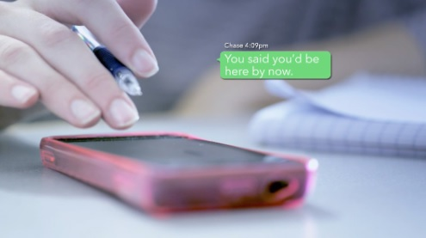
Question 8
If someone texted or messaged you over and over in a way that made you feel uncomfortable, what would you do?
What do you think Chase is trying to accomplish with his constant texting?
How can you develop healthy virtual boundaries with your partner?
Notes:
Information on your whereabouts is not “owed”.
If you feel that someone is demanding to know your whereabouts, doesn’t want you to go certain places, or implies that you “owe” them information about what you are doing or why, those are signs of an unhealthy, abusive relationship. In healthy relationships, people feel free and unpressured. Chase is trying to control Paige through texting, and at this stage in their relationship, just blocking his number may not be enough to stop his attempts to gain control over her.
Your partner should respect your comfort levels when it comes to staying in touch.
People have different comfort levels regarding how often they like to stay in touch. Being attentive means being considerate of your feelings, whereas being controlling is a way of dominating you and neglects your feelings.
Find a happy medium together.
If two people want to text all day—and they are both enjoying it—that’s fine. It becomes unhealthy if two people don’t talk about healthy boundaries, or if one person assumes that they can text all the time regardless of what the other person wants. In a healthy relationship, both people care equally about the other’s comfort level. There should be mutual agreement about how often you communicate.

Slide 14
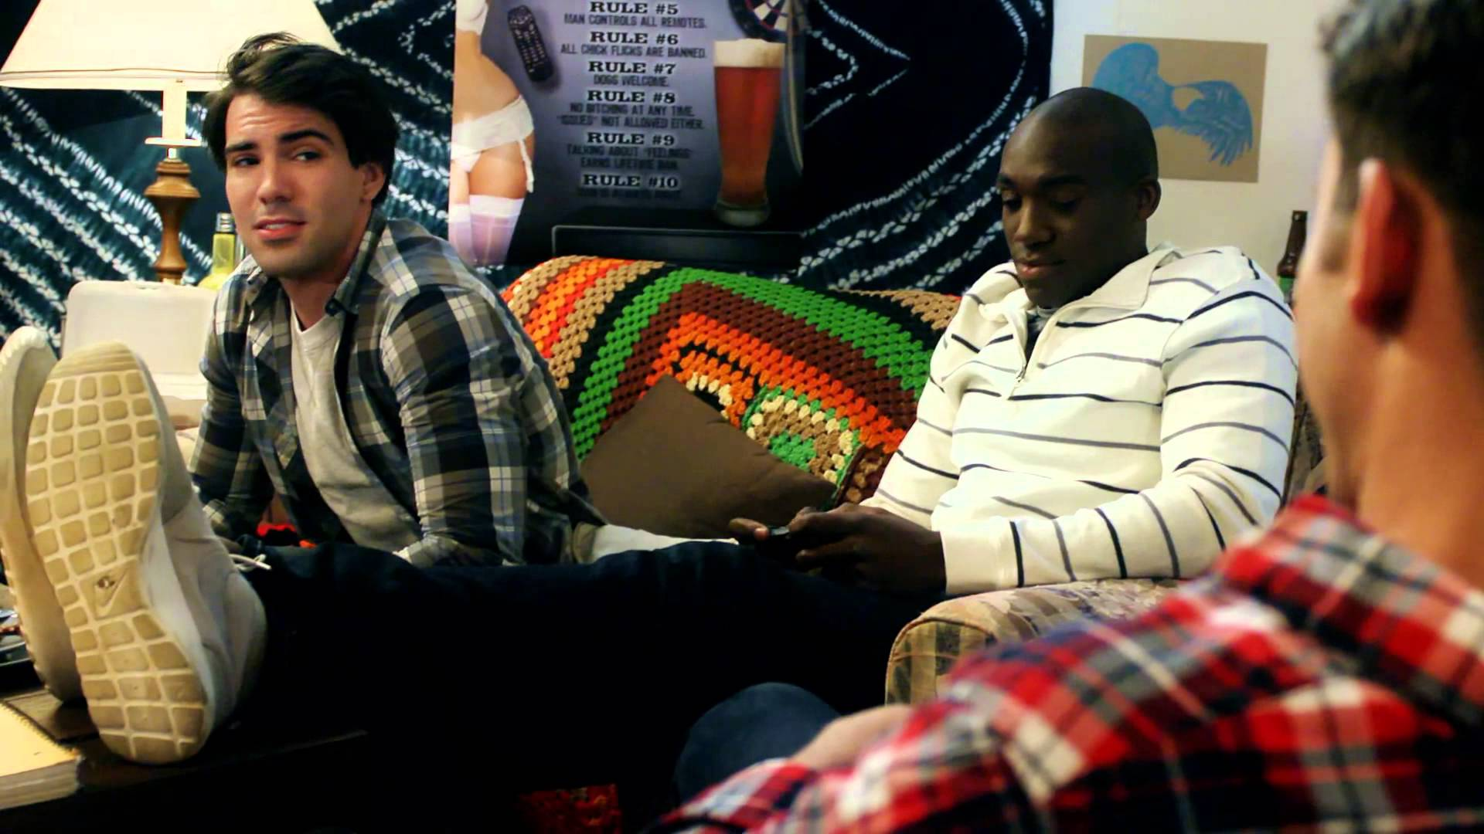
Question 9
At one point, Chase brags to his roommate that Paige does anything he wants sexually. How do his roommate react and why do they react this way?
What could Chase’s roommates have said?
Do you think it is common for friends to have these types of conversations?
Notes:
Disrespectful and degrading comments perpetuate a culture that tolerates violence.
It is natural for people to talk to their closest friends about their sex lives, particularly to talk about experiences or ask for advice. That is entirely different from bragging to friends about what you can “get someone to do” in bed. Chase wasn’t talking to his friends about his sex life because he wanted advice. His purpose was to boast about his power over Paige. If you hear someone boasting about controlling someone else sexually, or objectifying another person, let that person know that they have crossed a line and that their behavior only makes them look bad. Keep in mind that if you thought the comment was weird, it is likely that it made others feel uncomfortable as well – be a leader by saying
something, anything, to call that person out. Even a simple, “Whoa, why would you say that?” can be impactful!
Sex is about mutual respect, not power.
If you have a friend who talks to you about feeling sexually pressured by a partner, sensitively remind your friend that sexual pressure, coercion, or force all count as abuse and are signs that the relationship is unhealthy and could become worse over time. There is never an excuse for these behaviors. Speak to your friend about how, in a healthy relationship, both partners feel equally respected and satisfied sexually, and nobody is pushing his or her agenda on the other. Remember to support your friend, even when you don’t support their relationship. If you feel that sexual satisfaction is one sided, you should feel empowered to talk to your partner about your needs. Again, if you are not comfortable talking to your partner, that's a sign that things could be off in your relationship.

Slide 15
Question 10
What was Paige and Chase’s fight about (when they first broke up at the party), and what role did alcohol play?
Why do you think it is a warning sign of an abusive relationship when a couple is constantly breaking up and getting back together?
Notes:
It’s not just how they respect you, it’s how they respect everyone.
If a partner insults your friends, that’s a sign of an unhealthy relationship. In a healthy relationship, a caring partner might have questions about certain friends or even family members, but the right thing to do is to raise those concerns calmly and in a manner that doesn’t blame, shame, or judge. Your partner doesn't need to be best friends with your friends, but they should always respect them and your decision to be friends with them.
There is a difference between an “excuse” and a “reason.”
In this scene, alcohol plays the role of an excuse – “Oh, we were just drunk, neither of us meant what we said.” But it is important to recognize the difference between a reason and an excuse. Being drunk may be the reason that the fight escalated, but that is no excuse for the fact that Chase said what he said. People are responsible for their actions whether they are drunk or sober. Also, alcohol or other stressors don’t cause a person to bring out an unhealthy behavior that they weren’t capable of to begin with. Alcohol doesn’t belittle someone – a person belittles someone.
On and off again relationships indicate an unhealthy battle for control.
It is a sign of an abusive relationship if the situation is “on-again, off-again” because it shows that conflict is not being discussed or resolved using healthy communication. People in abusive relationships often attempt to break up with their partner several times, but may stay in or return to the relationship because they feel guilty, don’t want to be lonely, or have family or religious pressures to forgive and forget – causing an “on-again, off- again” situation. Some might feel as though they are abandoning their partner by breaking up with them because of the "ride-or-die" mentality that society perpetuates. But ultimately, you’re not a bad person if you walk away or abandon an unhealthy or abusive situation. Self-love should always come first – there are problems that we are not equipped to fix, and that will only eat away at us.
Establish a safe breakup plan with someone.
Because breakups can be especially dangerous for people in abusive relationships, it is a good idea for friends to talk to each other about their plans for breaking up with someone and carry out the break up in a planned, safe way. A spur-of-the-moment break up is more likely to lead to an “on-again, off- again” pattern as opposed to a planned breakup.
Note: Check out the Safety Plan on page 46 in the Appendix for more information.
Abuse doesn’t always start out extreme.
It is important to note that people like Chase do not typically begin relationships with overt signs of abuse, like physical or sexual violence. Offenders will often have established beliefs and attitudes about other groups of people that reinforce a sense of power over others – such as racism, sexism, homophobia, ableism, and so on. A potential perpetrator might “test the water” with a racist joke or sexist remark (like Chase referring to Meg as a “hooker”). If met with a positive response or even apathy, the person will gradually increase their aggressions until it includes overt relationship violence and abuse. It is especially important that we are intervening, even in the moments that seem “small,” because putting an end to relationship abuse includes putting a stop to the verbal aggression and negative attitudes that support violence

Slide 16
Question 11
What do you think Chase’s true motivation is for pressuring Paige into taking explicit photos?
Why do you think Paige agreed to let Chase take these photos for her even though she initially said no? Do you think that this is ever a safe or okay thing to do?
What would you do if someone showed you explicit photos of another person?
Notes:
Photos and texts are never truly deleted -- the internet is forever.
Even if you trust your partner or know that they will delete the pictures immediately, this could not be a safe practice because once a picture is taken, it never truly disappears – even on Snapchat! Remember that with anything you share, there is always the possibility that another audience may see it.
Sharing explicit photos could create an unhealthy power imbalance.
This is a common theme in abusive relationships and an increasing problem in the social media world. Once abusers have explicit photos of their partners, they “own them” or control them because they can (and often do) use explicit photos as blackmail. This creates an unhealthy power dynamic in a relationship.
Additionally, in LGBTQ relationships, these photos could be used as blackmail to out their partner. While it may seem normal to exchange these types of photos in a relationship, the manner in which Chase coerces Paige shows that he is exhibiting sexual ownership, objectification and possessiveness over Paige. A dangerous red flag is when an abuser manipulates their partner into doing something that would allow the abuser to have an advantage over them (i.e., the nude photos being used as blackmail).
Guilt-tripping is a red flag for abuse.
Chase showed that he lacked respect for Paige's decision when he coerced her by asking repeatedly and guilt-tripping her about the “long, cold nights over winter break.” If your partner is pressuring you into doing anything that you are uncomfortable with, that is a clear sign of an unhealthy relationship. In a healthy relationship, your partner will not try to convince you or pressure you into doing something that you are not completely comfortable with.
Not acting when someone is disrespectful contributes to a culture where abuse is tolerated.
If you don’t say anything when someone shows you an explicit photo or does something to objectify another person, you are contributing to a cycle of disrespect, so be sure to intervene. Some examples of ways to intervene could be to say: “Why are you showing me that! Do they know that you’re showing me this photo?” or “You should delete that from your phone. I’m sure they wouldn’t like to know that you’re showing people this.” Even a simple “Shouldn’t you keep that just between you two?” will get the message across

Slide 17

Question 12
What do you think Paige is thinking about she is strangled in the woods under the bridge?
Why did Chase hug Paige immediately after having grabbed her and put his hands around her throat?
Why do you think Paige and Chase’s friends didn’t follow them? What could they have done differently?
Notes:
Traumatic Bonding Theory.
One potential explanation for why Paige may have walked back over to hug Chase in that scene is Traumatic Bonding Theory. This theory states that abusers and victims can feel closer after an abusive incident because they feel that they have survived this conflict together.
There is never an excuse for someone who has used physical violence.
Even if they are going through a difficult time or have had a tough past, this does not excuse them for the abuse; there is nothing that makes it okay. There are plenty of people going through difficult times who don’t harm their partners.
You cannot fix your partner’s problems.
It is not the responsibility of a girlfriend or boyfriend to fix their partner’s problems; this is a job for a trained, expert counselor. Counseling programs cannot be expected to change the behavior of abusive people within the course of the relationship. Your first priority needs to be your safety. If you stay with your abusive partner, you might prevent them from recovering in a holistic way.
No one ever deserves to be abused.
Nobody deserves to be hit, hurt, or strangled — no matter what they’ve done. Even if you have done things in your relationship that you are not proud of (such as cheating on your partner), it is still not okay for your partner to hurt you and it is illegal.
Physical violence is likely to occur more than once.
If physical violence has occurred, it is not a good idea to continue the relationship. No matter what the abusive partner promises, physical violence is likely to occur again and the intensity of that violence could get worse and worse each time. It is important for both parties to talk to friends, family, teachers, counselors, and/or authorities about the incident.
If your partner has strangled you in the past your risk of being killed by them is
seven times higher.¹ Additionally, strangulation is one of the most lethal forms of abuse because unconsciousness may occur within seconds and death within minutes. While physical abuse is never okay, any form of strangulation is a particularly high indicator of lethality in the future.
¹ Glass, N., Laughon, K., Campbell, J., Block, C. R., Hanson, G., Sharps, P. W., & Taliaferro, E. (2008). Non-fatal Strangulation
is an Important Risk Factor for Homicide of Women. The Journal of Emergency Medicine, 35(3), 329-335. doi:10.1016/j.
jemermed.2007.02.065
As a friend, don’t turn a blind eye to what you are seeing.
Your safety always comes first, but as a friend, be sure to monitor the situation. Paige and Chase’s friends could have: followed them to diffuse the situation (if they felt safe enough to do so), called a resource to help (campus resources, outside resources, or another friend), or followed up with Chase and Paige to see if they were okay

Slide 18
Question 13
There is a scene in which Paige and Chase are alone in a car and she tells him that she loves him and only him. Why do you think Paige said that?
Why would anyone love someone who doesn’t treat them respectfully?
Notes:
Stockholm Syndrome.
Paige may begin to see things from Chase's point of view more than her own, and replace her own feelings and desires with those that Chase wants her to have.
You’re not a bad person if you walk away or abandon an unhealthy or abusive situation.
Some people have unhealthy attachment styles that cause them to be needy or dependent on their partner, and feel terror about the idea of losing that person. They may say things like “I would die if you ever broke up with me” or
“nobody could ever love you as much as I do.” It is not the responsibility of a girl-friend or boyfriend to fix their partner’s problems; this is a job for a trained, expert counselor. Self-love should always come first – there are problems that we are not equipped to fix, and that will only eat away at us.
It's not your job to "save" your partner.
Someone may feel that they are the only person that can help their partner from whatever they are struggling with (stress, depression, alcoholism, parents’ divorce, etc.). You could feel responsible for your partner and believe you understand why they act in an unhealthy way, so you want to be the one to help them end their unhealthy behaviors. But it is never your job to save someone else, especially at your own expense.
Threats of self-harm are red flags for abuse.
It is natural to feel that you would be extremely upset if your partner left you, but it is not healthy to feel that you would harm yourself or others if your partner left you. Note the difference in what Chase
says during this scene compared to what Paige’s father says to her mother later in the film: “I don’t know what I’d do without you, honey!” which is said in admiration, not to manipulate Paige's mother from ever leaving him.

Slide 19

Question 14
Why doesn’t Paige tell her mother more about her relationship when she goes home, particularly after Chase shows up unexpectedly?
Why would you hesitate to tell a parent, aunt, uncle, or other important person in your life what is truly going on?
Notes:
Abuse is never your fault.
It’s common for people to feel like they have done something naive by “getting into a bad relationship,” and then feel embarrassed to talk about it with others. Sometimes it seems easier to try to cover it up by saying
an unhealthy or abusive incident was a one-time mistake that will never happen again than to admit that they feel scared, confused, depressed or unsure about the relationship. They may also not tell the full truth about the situation because
they don’t want their friend or parent to dislike their partner.
When supporting a loved one, emphasize acceptance, patience, and love.
The best thing a family member or friend can do is to remain non-judgmental. If you try to force someone in an abusive relationship to talk to you, you are teaching them that force is normal in caring relationships. If you use patience, gentleness, and acceptance until they are ready, you are teaching an important lesson that loving relationships are about respect and safety. When talking to them about their relationship, focus the conversation on how these behaviors are impacting their life – which might help them realize the severity of the situation.
Be cautious of how you talk about your own relationship with your friend.
If your friend is in an unhealthy situation and your own relationship is fantastic, be conscious of not rubbing it in their face accidentally. On the one hand, positive examples of healthy love are really great! On the other hand, be aware that it can further alienate someone if they feel like they're the only one who's been in an abusive relationship. Your friend might open up to you more if you give an example from your own relationship of a time where there was conflict and how it
was resolved in a healthy way.
If you don’t feel comfortable speaking with your parents about your relationship(s), seek support from a friend or trusted resource.
Keep in mind that if you identify as LGBTQ and feel that your parent does not support your sexuality or gender identity, you may not feel comfortable talking to them about your relationship. Remember that, for any reason, if you would like to speak with someone about what you are going through, but don’t feel comfortable speaking with your parent, you should try to find another person that you trust. There are counselors and advocates that you may feel more comfortable reaching out to and you can consult the list of national resources in the Appendix

Slide 20
Question 15
After dinner, Paige’s mom has a conversation with her in private. She tells Paige, “If he doesn’t make you feel like a better person, it’s not love.” What are some other qualities that you believe make up a healthy relationship, and can you provide some examples of when you’ve seen these positive behaviors?
Notes:
It's important to understand what behaviors make up a healthy relationship.
A healthy relationship is made up of qualities that build you up and make you feel good about yourself. In a healthy relationship, your partner will empower you to be your best self, and you won't question if you're being treated with respect.
Some signs of a healthy relationship include: independence, compassion, trust, respect, equality, and honesty, among others.
Going through abuse is not just “a difficult time.”
No matter how you define love, being psychologically, physically, and/or sexually abused should not be part of it. Don't mistake abuse for being "just a bump in the road." Even if you know that your partner loves you, if they are not loving you the way that you want to be loved, that is not a healthy relationship.
The difference between healthy and unhealthy conflict lies in respectful communication.
When experiencing conflict in a healthy relationship, you do not feel afraid or anxious. You feel comfortable communicating with your partner honestly, feel that you can be yourself around them, and that you are being heard.
Friends don’t always know the full story.
It's natural to talk to friends about your relationship or dating life. But keep in mind that while friends may have the best intentions, they may not always give the best advice. It's important to consult a
relationship expert or professional resource if you are struggling with something in your personal life or relationship. If you sense that someone close to you is going through something difficult in their personal life or relationship, suggest that they speak with a counselor or professional resource. It is perfectly okay to get help from outside resources if there's a crisis and you don't feel comfortable intervening directly. You don’t have to be involved directly if you are not comfortable doing so.

Slide 21

Question 16
At the end of the film, the friends are interviewed by a detective. He asks them if they saw signs that the relationships was abusive. They say yes, and each one gives a different explanation for why they didn’t think what they saw warranted further action from them. What are some of their reasons?
Why did Chase behave in an abusive way, and how could people in his life or Paige’s life have intervened or responded differently to prevent Paige’s death?
What can we do to work toward healthier relationships and to prevent relationship abuse in our community?
Notes:
Any sign you see is just one piece of the puzzle, so it's better to be safe than sorry and have a conversation with your friend.
As a friend, do not ignore the signs that you see in a friend or loved one. Remember that someone will not leave an abusive situation because you tell them to; they need to make that decision on their own. However, you can help lead them to that decision by reminding them that everyone deserves to feel safe and happy in their relationship. Kindly talk to your friend about the signs that you see as you see them, and then follow up on those conversations – understand that it will likely take many, many of these talks before your friend chooses to leave their partner. Also, while it is your job to say something, it is okay to set boundaries to help take care of yourself as you take care of your friends. If you don't feel comfortable intervening in a situation, getting help from a counselor is a great alternative.
Talk to another close friend for help approaching the situation.
If you don’t feel comfortable talking to your friend about their relationship, consider talking to another friend who might be noticing these behaviors too. You and your friend can be two sets of eyes on the situation and can intervene together if need be, but be sure to do so in a non-judgmental and supportive way
When talking to someone about an unhealthy behavior, be sure to call out the behavior instead of labeling a person as "abuser" or "victim."
Many people don’t want to label their partner or themselves as “abusive,” so it can be helpful to label the behaviors, not the person. You can say that the person is exhibiting or experiencing “unhealthy behaviors,” and help them see how this behavior is not normal. The best thing you can do as a friend or loved one is to encourage them to get help from a professional. Also, always think of your own safety first, as it might be dangerous to confront someone who you know has been physically abusive.
Abusive behavior can stem from a number of different risk factors.
Past trauma, codependency, a sense of abandonment, familial rejection or neglect, inability to communicate about emotions, lack of validation from outside parties, and objectification of women are all risk factors for abusive behavior. If you have a friend that is exhibiting unhealthy or abusive behavior, it's important that you talk to them about the behavior as you see it and encourage them to seek help. Keep reminding your friend that no matter the reason, violence is not the answer. An abusive person is extremely unlikely to respond positively to being told that they are an abuser. Going along with your friend, and pretending it is stress, might get that person to accept help faster than trying to get them to admit they are perpetrating relationship abuse. You can also destigmatize mental health treatment by telling your friend about a time that you or someone you know needed help and sought mental health counseling.
Know your resources.
We have provided you with a list of resources on this campus and in our community. Feel free to contact any of these people to learn more about what types of services they can provide, and consider scheduling a meeting with them so you can understand what resources are available within your community

Slide 22
Question 17
What, if anything, do you think that you will do differently after having watched this film and had this discussion?
Is there anything else you would like to add?
Notes:
Don't discount subtle signs of abuse.
Be aware of the subtler signs of abuse that often get discounted, and don’t make excuses for people who abuse. Remember that emotional abuse is a very serious form of abuse. Recognize that there are reasons that people exhibit abusive behaviors, but there is no excuse for those behaviors. Trust your gut — if you feel that something is off, take the time to analyze how you are feeling and speak to your partner, friends, or family about it.
Relationship abuse is far more common than most people think.
1 in 3 women and 1 in 4 men will be in an abusive relationship at some point in their lives, so it's important to be aware of the warning signs and intervene when you suspect a friend is abusive or being abused. Understand that these conversations with your loved one need to continue over time. Do not stay in an unhealthy relationship and be sure to create a safety plan before the breakup. Leave an unhealthy situation before it escalates to abuse. Look over the local resources and know who to turn to if you need help.

Slide 23
Thank You!
Take out your phones!
Go to joinonelove.org/feedback and let us know what you thought about this workshop.
This feedback is incredibly helpful to One Love and at the end you will find an opportunity to provide your information and get involved.
We will give you all a few minutes to complete the feedback form – it really only takes 30 seconds!
Notes:
Before we wrap up today, I want to first thank you all for participating in this discussion. I believe
that in order to change the statistics around relationship abuse, we need to have more conversations like the one we had today about healthy and unhealthy relationships. We also need people
like you to take action.
Now is your time to join us. I took action and became a One Love facilitator – and there are so many ways you can get involved too! This workshop is just the beginning. One Love has lots of campaigns, activations, and leadership opportunities. But the easiest thing I can ask you can to do today is:
(Take out your own phone) Go to joinonelove.org/feedback and let us know what you thought about this workshop.
This feedback is incredibly helpful to One Love and at the end you will find
an opportunity to provide your information and get involved.
I will give you all a few minutes to
complete the feedback form – it really only takes 30 seconds! (Give people a few minutes to fill this out, while they are still in the room)
Thank you again for participating. If you would like to learn more about getting involved with One
Love, please stay after and we can chat!

